Slide 1
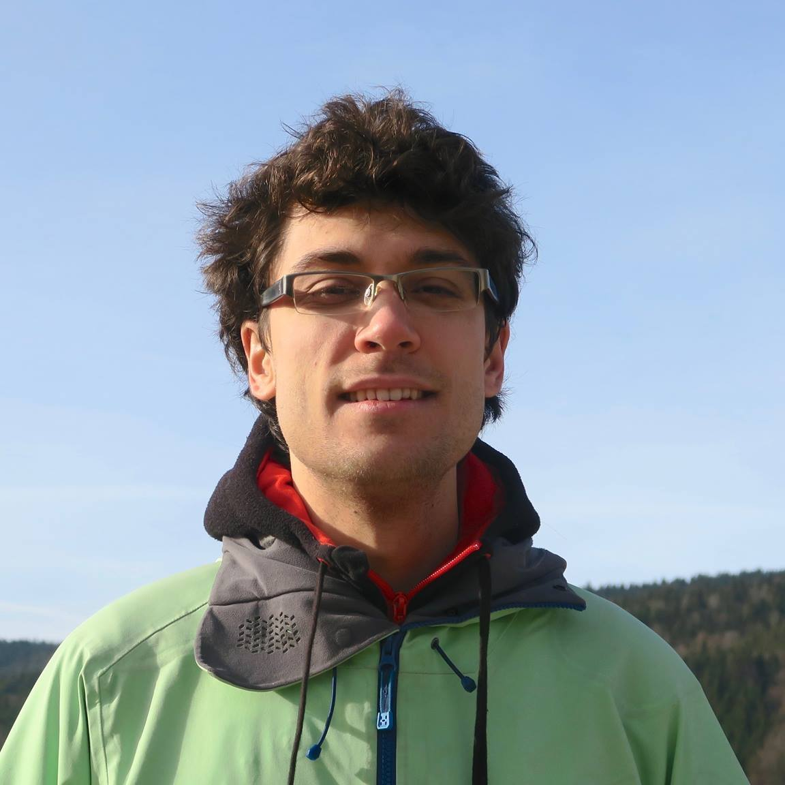

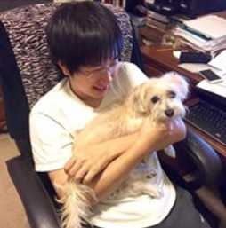
Streaming Euclidean $k$-median and $k$-means with $o(\log{n)}$ Space
Vincent Cohen-Addad
David P. Woodruff
Samson Zhou

Slide 2
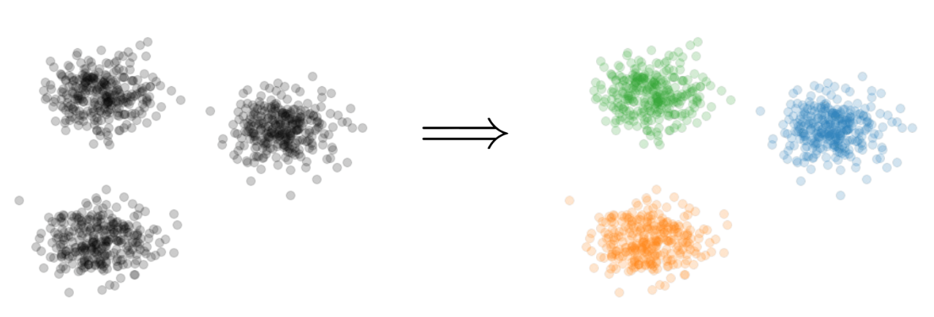
$k$-Clustering
Goal: Given input dataset $X$, partition $X$ so that “similar” points are in the same cluster and “different” points are in different clusters
There can be at most $k$ different clusters
$$k=3$$

Slide 3
$k$-Clustering
Define clustering cost $Cost\left(X,C\right)$ to be a function of ${\left\{dist\left(x,C\right)\right\}}_{x∈C}$
$k$-center: $Cost\left(X,C\right)=\max_{x∈X}{dist(x,C)}$
$k$-median: $Cost\left(X,C\right)=\sum_{x∈X}{dist\left(x,C\right)}$
$k$-means: $Cost\left(X,C\right)=\sum_{x∈X}{{\left(dist\left(x,C\right)\right)}^{2}}$
$(k,z)$-clustering: $Cost\left(X,C\right)=\sum_{x∈X}{{\left(dist\left(x,C\right)\right)}^{z}}$
$${\left(⋅\right)}^{z}$$
$${\left(⋅\right)}^{z}$$
$${\left(⋅\right)}^{z}$$
$${\left(⋅\right)}^{z}$$
$${\left(⋅\right)}^{z}$$
$${\left(⋅\right)}^{z}$$
$${\left(⋅\right)}^{z}$$

Slide 4
Euclidean $k$-Clustering
For Euclidean $k$-clustering, input points $X=x_{1},…,x_{n}$ are in $ℝ^{d}$ (for us, they will be in ${[Δ]}^{d}≔{\left\{1,2,…,Δ\right\}}^{d}$)
$dist\left(x,y\right)=\sqrt{{\left(x_{1}−y_{1}\right)}^{2}+…+{\left(x_{d}−y_{d}\right)}^{2}}$ is the Euclidean distance
$(k,z)$-clustering problem:
$$\min_{C:\left|C\right|≤k} Cost\left(X,C\right)=\min_{C:\left|C\right|≤k}{Σ_{x∈X}\left(dist\left(x,C\right)\right)}^{z}$$

Slide 5
The Streaming Model
Input: Updates to an underlying data set $X$ that arrive sequentially
Output: Evaluation (or approximation) of a given function
Goal: Use space sublinear in the size $n$of the input $X$

Slide 6
Goal: Cluster a stream of $n$ points using $o(\log{n)}$ space

Slide 7
Our Results (Insertion-Only)
There exists a one-pass algorithm on insertion-only streams that outputs $(1+ε)$-approximation for $(k,z)$-clustering for all times in the stream and uses $\tilde{O}\left(\frac{dk}{ε^{2}}\right)⋅\min\left(k,\frac{1}{ε^{z}}\right)⋅poly(\log{\log{nΔ)}}$ words of space
Our algorithm outputs $(1+ε)$-coreset constructions for $(k,z)$-clustering for all times in the stream

Slide 8
Our Results (Insertion-Deletion Impossibility)
Any one-pass algorithm on insertion-deletion streams that outputs a $2$-approximation to the $(k,z)$-clustering cost at all times in the stream with $d=Ω\left(\log{n}\right)$ must use $Ω\left(\log^{2}{n}\right)$ bits of space
Any one-pass algorithm on insertion-deletion streams that outputs a $2$-approximation to the $(k,z)$-clustering cost from a weighted subset of the input must use $Ω\left(\log^{2}{n}\right)$ bits of space

Slide 9
Our Results (Insertion-Deletion Two-Pass)
There exists a two-pass algorithm on insertion-deletion streams that outputs a $(1+ε)$-coreset construction for $k$-median and $k$-means clustering that uses $\tilde{O}\left(\frac{1}{ε^{2}}\right)⋅poly\left(d,k,\log{\log{nΔ}}\right)$ words of space
Result generalizes to $z∈[1,2]$

Slide 10
Our Results (Sum of the Online Sensitivities)
Sum of the online sensitivities of a set of $n$ points in $ℝ^{d}$ for $(k,z)$-clustering is at most $O\left(k\log^{2}{(ndΔ)}\right)$

Slide 11
Coreset
Subset $X′$ of representative points of $X$ for a specific clustering objective
$Cost\left(X,C\right)≈Cost(X^{′},C)$ for all sets $C$ with $\left|C\right|=k$

Slide 12
Coreset
Subset $X′$ of representative points of $X$ for a specific clustering objective
$Cost\left(X,C\right)≈Cost(X^{′},C)$ for all sets $C$ with $\left|C\right|=k$

Slide 13
Coreset
Subset $X′$ of representative points of $X$ for a specific clustering objective
$Cost\left(X,C\right)≈Cost(X^{′},C)$ for all sets $C$ with $\left|C\right|=k$

Slide 14
Coreset (Formal Definition)
Given a set $X$ and an accuracy parameter $ε>0$, we say a set $X′$ with weight function $w$is an $(1+ε)$-multiplicative coreset for a cost function $Cost$, if for all queries $C$ with $\left|C\right|≤k$, we have
$$\left(1−ε\right)Cost(X,C)≤Cost(X′,C,w)≤\left(1+ε\right)Cost(X,C)$$
$(k,z)$-clustering: $Cost\left(X^{′},C,w\right)=\sum_{x∈X′}{{w\left(x\right)⋅\left(dist\left(x,C\right)\right)}^{z}}$

Slide 15
Coreset Constructions
Let $\tilde{O}\left(f\right)$ denote $f⋅polylog(f)$
For $(k,z)$-clustering, there exist coreset constructions that only require $\tilde{O}\left(\frac{k}{ε^{2}}\right)⋅\min\left(k,\frac{1}{ε^{z}}\right)$ weighted points of the input [Cohen-AddadLarsenSaulpicSchweighelshohn22]
Independent of input size $n$

Slide 16
$(k,z)$-Clustering in the Streaming Model
Merge-and-reduce framework
Suppose there exists a $(1+ε)$-coreset construction for $(k,z)$-clustering that uses $f\left(k,\frac{1}{ε}\right)$ weighted input points
Partition the stream into blocks containing $f\left(k,\frac{\log{n}}{ε}\right)$ points
$$\tilde{O}\left(\frac{k^{2}}{ε^{2}}\right)$$

Slide 17
$(k,z)$-Clustering in the Streaming Model
Partition the stream into blocks containing $f\left(k,\frac{\log{n}}{ε}\right)$ points
Create a $\left(1+\frac{ε}{\log{n}}\right)$-coreset for each block
Create a $\left(1+\frac{ε}{\log{n}}\right)$-coreset for the set of points formed by the union of two coresets for each block
Reduce
Merge

Slide 18
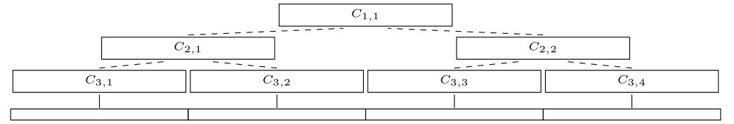
$(k,z)$-Clustering in the Streaming Model
Partition the stream into blocks containing $f\left(k,\frac{\log{n}}{ε}\right)$ points
Create a $\left(1+\frac{ε}{\log{n}}\right)$-coreset for each block
Create a $\left(1+\frac{ε}{\log{n}}\right)$-coreset for the set of points formed by the union of two coresets for each block

Slide 19
$(k,z)$-Clustering in the Streaming Model
There are $O\left(log n\right)$ levels
Each coreset is a $\left(1+\frac{ε}{\log{n}}\right)$-coreset of two coresets
Total approximation is ${\left(1+\frac{ε}{\log{n}}\right)}^{\log{n}}=(1+O\left(ε\right))$

Slide 20
$(k,z)$-Clustering in the Streaming Model
Suppose there exists a $(1+ε)$-coreset construction for $(k,z)$-clustering that uses $f\left(k,\frac{1}{ε}\right)$ weighted input points
Partition the stream into blocks containing $f\left(k,\frac{\log{n}}{ε}\right)$ points
Total space is $f\left(k,\frac{\log{n}}{ε}\right)⋅O(log{n)}$ points
For $k$-means clustering, this is $\tilde{O}\left(\frac{k^{2}}{ε^{2}}⋅\log^{3}{n}\right)$ points

Slide 21
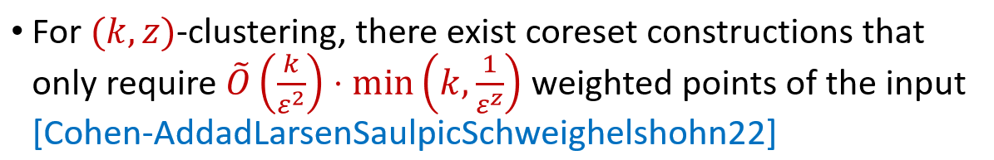
$(k,z)$-Clustering in the Streaming Model
Suppose there exists a $(1+ε)$-coreset construction for $(k,z)$-clustering that uses $f\left(k,\frac{1}{ε}\right)$ weighted input points
Partition the stream into blocks containing $f\left(k,\frac{\log{n}}{ε}\right)$ points
Total space is $f\left(k,\frac{\log{n}}{ε}\right)⋅O(log{n)}$ points

Slide 22
$(k,z)$-Clustering in the Streaming Model
Suppose there exists a $(1+ε)$-coreset construction for $(k,z)$-clustering that uses $f\left(k,\frac{1}{ε}\right)$ weighted input points
Partition the stream into blocks containing $f\left(k,\frac{\log{n}}{ε}\right)$ points
Total space is $f\left(k,\frac{\log{n}}{ε}\right)⋅O(log{n)}$ points
Do there exist streaming algorithms for $(k,z)$-clustering that use $o(\log{n)}$ words of space?

Slide 23
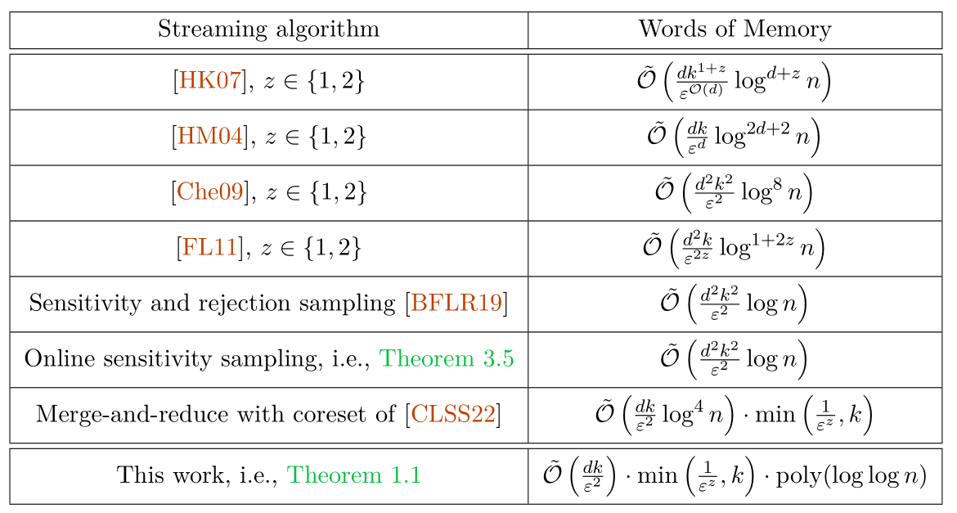

Slide 24
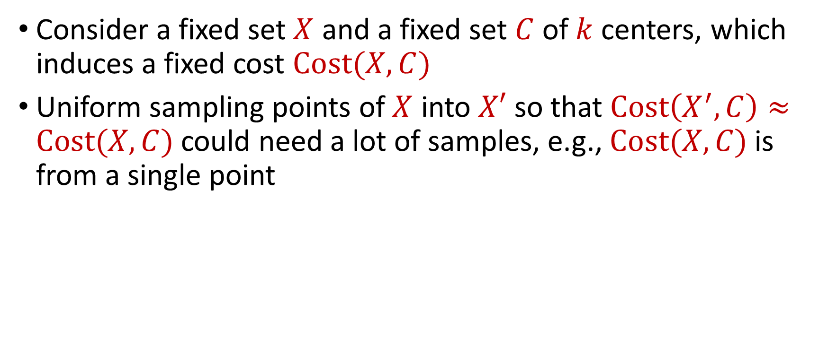
Coreset Construction and Sampling
Consider a fixed set $X$ and a fixed set $C$ of $k$ centers, which induces a fixed cost $Cost(X,C)$
Uniform sampling points of $X$ into $X′$ so that $Cost\left(X^{′},C\right)≈Cost(X,C)$could need a lot of samples, e.g., $Cost(X,C)$is from a single point

Slide 25
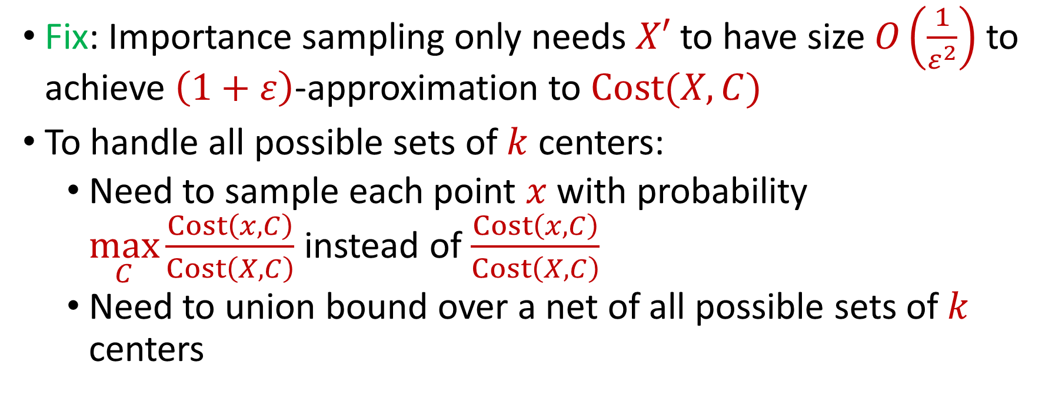
Coreset Construction and Sampling
Fix: Importance sampling only needs $X′$ to have size $O\left(\frac{1}{ε^{2}}\right)$ to achieve $\left(1+ε\right)$-approximation to $Cost(X,C)$
To handle all possible sets of $k$ centers:
Need to sample each point $x$ with probability $\max_{C}\frac{Cost\left(x,C\right)}{Cost\left(X,C\right)}$ instead of $\frac{Cost\left(x,C\right)}{Cost\left(X,C\right)}$
Need to union bound over a net of all possible sets of $k$ centers
Net with size ${\left(\frac{nΔ}{ε}\right)}^{O(kd)}$

Slide 26
Sensitivity Sampling
The quantity $s\left(x\right)=\max_{C}\frac{Cost\left(x,C\right)}{Cost\left(X,C\right)}$ is called the sensitivity of $x$ and intuitively measures how “important” the point $x$ is
The total sensitivity of $X$ is $\sum_{x∈X}{s(x)}$ and quantifies how many points will be sampled into $X′$ through importance/sensitivity sampling (before the union bound)

Slide 27
Online Sensitivity
In a data stream, computing/approximating sensitivity $s\left(x\right)=\max_{C}\frac{Cost\left(x,C\right)}{Cost\left(X,C\right)}$ requires seeing the entire dataset $X$, but then it is too late to sample $x$
We define the online sensitivity of $x_{t}$ with respect to a stream $x_{1},…,x_{n}$ to be $φ\left(x_{t}\right)=\max_{C}\frac{Cost\left(x_{t},C\right)}{Cost\left(X_{t},C\right)}$, where $X_{t}=x_{1},…,x_{t}$, which intuitively measures how “important” the point $x$ is SO FAR

Slide 28
Online Sensitivity
Streaming algorithm: sample each point $x_{t}$ with probability $p\left(x_{t}\right)=\min\left(1,\frac{kd}{ε^{2}}⋅polylog\left(nΔ\right)⋅φ(x_{t})\right)$
How to compute (or approximate) $φ(x_{t})$?

Slide 29
Online Sensitivity
Observation: we can use a $\left(1+ε\right)$-coreset to obtain a $\left(1+ε\right)$-approximation to $φ\left(x_{t}\right)$
Use samples obtained from online sensitivity sampling at each time $t−1$ to obtain a $\left(1+ε\right)$-approximation to $φ\left(x_{t}\right)$
Can then perform online sensitivity sampling at time $t$ and by induction, at all times in the stream

Slide 30
Online Sensitivity
Streaming algorithm: sample each point $x_{t}$ with probability $p\left(x_{t}\right)=\min\left(1,\frac{kd}{ε^{2}}⋅polylog\left(nΔ\right)⋅φ(x_{t})\right)$
Given our new bounds on total sensitivity, we get a coreset of size $\sum_{t}{p\left(x_{t}\right)}=\frac{k^{2}d}{ε^{2}}⋅polylog\left(nΔ\right)$
Sampling is done online, can view as a new stream $X′$

Slide 31
Insertion-Only Algorithm
Perform online sensitivity sampling to implicitly create new stream $X′$
In parallel, run merge-and-reduce on $X^{′}$

Slide 32
Insertion-Only Summary
New stream $X′$ has length $\frac{k^{2}d}{ε^{2}}⋅polylog\left(nΔ\right)$
Can run merge-and-reduce framework on $X^{′}$
Recall total space used by merge-and-reduce was $f\left(k,\frac{\log{n}}{ε}\right)⋅O(log{n)}$ points, but $n$ was the length of the stream
Total space is $f\left(k,\frac{\log{|S^{′}|}}{ε}\right)⋅O(log{|X′|)}$ points with $f\left(k,\frac{1}{ε}\right)=\tilde{O}\left(\frac{k}{ε^{2}}\right)⋅\min\left(k,\frac{1}{ε^{z}}\right)$, i.e., $o(\log{n)}$

Slide 33
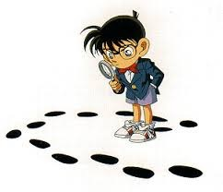
Questions?
Format
Part 1: Background
Part 2: Insertion-Only Streams
Part 3: $k$-Median on Dynamic Streams
Part 4: $(k,z)$-Clustering on Dynamic Streams

Slide 34
Insertion-Deletion Streams
Use first pass to estimate sensitivity of each point $n$ in the stream
Use second pass to perform sensitivity sampling

Slide 35
Sensitivity Estimation
Sensitivity of a point $x$is $s\left(x\right)≔\max_{C:\left|C\right|≤k}\frac{Cost\left(x, C\right)}{Cost\left(X, C\right)}$
Suppose $S$is the optimal (capacitated) set of $k$centers, so that $Cost\left(X,S\right)≤Cost(X,C)$ for all sets $C$of $k$ centers
Claim: $\frac{4⋅2^{z}⋅Cost\left(x,C\right)}{Cost\left(C,S\right)+Cost(X,S)}$ is a good approximation of $s\left(x\right)$

Slide 36
Sensitivity Estimation
$$\frac{Cost\left(x,C\right)}{Cost\left(X,C\right)}=\frac{4⋅Cost\left(x,C\right)}{4⋅Cost\left(X,C\right)}$$
$$≤\frac{4⋅Cost\left(x,C\right)}{2⋅Cost\left(X,C\right)+2⋅Cost(X,S)}$$
(Optimality of $S$)
$$≤\frac{4⋅Cost\left(x,C\right)}{Cost\left(X,C\right)+2⋅Cost(X,S)}$$
$$≤\frac{4⋅2^{z}⋅Cost\left(x,C\right)}{Cost\left(C,S\right)+Cost(X,S)}$$
(Triangle Inequality)

Slide 37
Sensitivity Estimation
$$\frac{4⋅2^{z}⋅Cost\left(x,C\right)}{Cost\left(C,S\right)+Cost(X,S)}≤\frac{2^{O(z)}⋅Cost\left(x,C\right)}{Cost\left(X,S\right)+Cost\left(X,C\right)}$$
(Triangle Inequality)
$$≤\frac{2^{O(z)}⋅Cost\left(x,C\right)}{Cost\left(X,C\right)}$$

Slide 38
Sensitivity Estimation
Takeaway: Can use a “good” (capacitated) set $S$ of $k$centers along with an approximation of its cost to estimate sensitivities $s\left(x\right)$ of all points
How to find such an estimate?
Cannot use online sensitivity sampling or merge-and-reduce anymore

Slide 39
Quadtree Embedding

Slide 40
Quadtree Embedding
$$Δ$$

Slide 41
Quadtree Embedding
$$Δ$$

Slide 42
Quadtree Embedding
$$Δ$$

Slide 43
Quadtree Embedding
Total cost: $0$
Level cost: $0$
7
$$Δ$$
6
6

Slide 44
Quadtree Embedding
Total cost: $\frac{Δ}{2}⋅7$
Level cost: $\frac{Δ}{2}⋅7$
7
$$Δ$$
6
6

Slide 45
Quadtree Embedding
Total cost: $\left(\frac{7}{2}+\frac{11}{4}\right)Δ$
Level cost: $\frac{Δ}{4}⋅11$
7
$$Δ$$
6
6

Slide 46
Quadtree Embedding
Earth mover distance: $EMD\left(C,X\right)$ denotes the $k$-median clustering cost $Cost\left(C,X\right)$for $X$ using a (capacitated) set $C$ of centers
Quadtree embedding: For a (weighted) set $C$ of centers, the quadtree embedding outputs $Z$ such that
$$EMD\left(C,X\right)≤O\left(\sqrt{d}\right)⋅Z≤⋅O\left(d^{1.5}\right)(\log{k+\log{\log{Δ)}}}EMD(C,X)$$

Slide 47
Quadtree Embedding
Quadtree embedding produces a vector of dimension $Δ^{O(d)}$
The computation of $Z$ is the sum of the level costs, which is the $L_{1}$ norm of the frequency vector
There exists a one-pass streaming algorithm that outputs a constant-factor approximation to the $L_{1}$ norm of a frequency vector in $ℝ^{n}$ and uses $O\left(\log{n}\right)$ bits of space [Indyk06]

Slide 48
$L_{1}$ Norm Approximation
There exists a one-pass streaming algorithm that outputs a constant-factor approximation to the $L_{1}$ norm of an underlying vector $x$ in $ℝ^{n}$ and uses $O\left(\log{n}\right)$ bits of space [Indyk06]
Generate vector $v_{1},…v_{α}∈ℝ^{n}$ of Cauchy random variables (ratio of two normal random variables) for $α=O(1)$
Output ${median}_{i∈\left[α\right]}\left\{\left|\left\langle v_{1},x\right\rangle \right|,…, \left|\left\langle v_{α},x\right\rangle \right|\right\}$

Slide 49
EMD Sketch
EMD sketch: There exists a one-pass streaming algorithm that uses $O\left(d\log{Δ}\right)$ bits of space and outputs $Z$ such that
$$EMD\left(C,X\right)≤O\left(\sqrt{d}\right)⋅Z≤⋅O\left(d^{1.5}\right)(\log{k+\log{\log{Δ)}}}EMD(C,X)$$

Slide 50
EMD Sketch
[BackursIndykRazenshteynWoodruff16] To estimate $\min_{C, \left|C\right|≤k} Cost(C,X)$, it suffices to union bound over a net of size $exp\left(kd\left(\log{\log{Δ}}\right)\right)$
EMD sketch: There exists a one-pass streaming algorithm that uses $O\left(kd^{2}\log{Δ}\left(\log{\log{Δ}}\right)\right)$ bits of space and outputs $Z$ (as well as the capacitated set of centers) such that
$$OPT≤O\left(\sqrt{d}\right)⋅Z≤⋅O\left(d^{1.5}\right)(\log{k+\log{\log{Δ)}}}OPT$$

Slide 51
EMD Sketch Summary
EMD sketch: There exists a one-pass streaming algorithm that uses $O\left(kd^{2}\log{Δ}\left(\log{\log{Δ}}\right)\right)$ bits of space and outputs $Z$ (as well as the capacitated set of centers) such that
Recall: Can use a “good” (capacitated) set $S$ of $k$centers along with an approximation of its cost to estimate sensitivities $s\left(x\right)$ of all points
$$OPT≤O\left(\sqrt{d}\right)⋅Z≤⋅O\left(d^{1.5}\right)(\log{k+\log{\log{Δ)}}}OPT$$

Slide 52
First Pass to Second Pass
We can set up the EMD sketch in the first pass of the stream
At the end of the first pass of the stream, we have a data structure that can estimate the sensitivity $s\left(x\right)$ for any query $x∈{\left[Δ\right]}^{d}$
In the second pass of the stream, we would like to perform sensitivity sampling

Slide 53
Sensitivity Sampling
DO NOT: Sample each point $x$ in the stream with probability proportional to $s\left(x\right)$
Does not work for insertion-deletion streams
DO: Sample each point $x$ in the universe ${\left[Δ\right]}^{d}$ into a substream $U′$ with probability proportional to $s(x)$
$U′$can have a large number of points
$U′$can have a small number of points at the end of the stream

Slide 54
Sensitivity Sampling
Sample each point $x$ in the universe ${\left[Δ\right]}^{d}$ into a substream $U′$ with probability proportional to $s(x)$
$U′$will have $poly\left(k,d,\frac{1}{ε^{2}}\right)$ points at the end of the stream
Use sparse recovery on $U′$

Slide 55
Sparse Recovery
Given a stream$U′$ that induces a frequency vector of length $n$ with $s$ nonzero entries, there exists an algorithm that uses $O\left(s\log{n}\right)$ bits of space and recovers the nonzero coordinates and their frequencies
Since elements are sampled into $U′$ by their sensitivities, recovering $U′$by sparse recovery corresponds to sensitivity sampling!

Slide 56
$k$-Median Framework
First pass: set up the EMD sketch
Second pass:
Sample elements into a substream $U′$ with probability proportional to their sensitivities
Run sparse recovery on $U′$

Slide 57
Questions?
Format
Part 1: Background
Part 2: Insertion-Only Streams
Part 3: $k$-Median on Dynamic Streams
Part 4: $(k,z)$-Clustering on Dynamic Streams

Slide 58
$k$-Median Framework
First pass: set up the EMD sketch
Second pass:
Sample elements into a substream $U′$ with probability proportional to their sensitivities
Run sparse recovery on $U′$

Slide 59
Quadtree Embedding
Level cost: $\frac{Δ}{4}⋅11$
7
$$Δ$$
6
6

Slide 60
Quadtree Embedding
Level cost: $\frac{Δ^{2}}{16}⋅11$
7
$$Δ$$
6
6

Slide 61
Quadtree Embedding
If $x$ and $c$ have distance $αΔ$, the probability it will be split by a grid of length $\frac{Δ}{2^{i}}$ is roughly $\frac{2^{i}}{α}$
Expected cost for $k$-median is $αΔ$
Expected cost of $k$-means is $\frac{Δ^{2}}{2^{i}α}$, i.e., distortion $2^{i}α^{3}$
Recall: worse EMD sketch guarantee corresponds to larger oversampling necessary for sensitivity sampling

Slide 62
Quadtree Embedding
Intuition: Bad distortion results when pairs of points are “too close” to the boundary of the hypergrid
Goal: Prevent this case from happening
Fix: When a query center is too close to the boundary of the hypergrid, create another center on the opposite cell!

Slide 63
Quadtree Embedding
7
$$Δ$$
6
6

Slide 64
Quadtree Embedding
7
$$Δ$$
6
6

Slide 65
Quadtree Embedding
7
$$Δ$$
6
6

Slide 66
Quadtree Embedding
7
$$Δ$$
6
6

Slide 67
Quadtree Embedding
7
$$Δ$$
6
6

Slide 68
Quadtree Embedding
Make a new center when distance from query center and hypergrid with length $2^{i}$ is at most $\frac{2^{i}}{d\log{Δ}}$
In expectation (over $d$ dimensions, $\log{Δ}$ levels of the hypergrid, and $k$ query centers), $O(k)$ new centers are created

Slide 69
Wasserstein Sketch
Wasserstein-$z$ distance: $WASSD\left(C,X\right)$ denotes the $(k,z)$-clustering cost $Cost\left(C,X\right)$for $X$ a (capacitated) set $C$ of centers
Wasserstein sketch: There exists a one-pass streaming algorithm that uses $O\left(d\log{Δ}\right)$ bits of space and outputs $Z$ such that
$$Z≤⋅O\left(d^{1+0.5z}\log^{z−1}{Δ}\right)⋅WASSD(C,X)$$

Slide 70
Applying $k$-Median Framework to $k$-Means
First pass: set up the Wasserstein sketch
Second pass:
Sample elements into a substream $U′$ with probability proportional to their sensitivities
Run sparse recovery on $U′$

Slide 71
Applying $k$-Median Framework to $k$-Means
Problem: Because the distortion of the Wasserstein embedding is $O\left(d^{1+0.5z}\log^{z−1}{Δ}\right)$, we need to sample $O\left(d^{2}\log{Δ}\right)$ points for $k$-means
For $k$-median, we stored all the points, using $O\left(d\log{Δ}\right)$ bits of space per point
Cannot afford to store all points explicitly here

Slide 72
Applying $k$-Median Framework to $k$-Means
Cannot afford to store all points explicitly here
Instead, store offset of each point from one of the centers of near-optimal solution $S$
For each point $x$, let $c_{x}$ be the closest center of $S$ and $y=c_{x}−x$
Round $y$ coordinate-wise to nearest power of $1+poly\left(\frac{ε}{log ndΔ}\right)$ and store the vector of exponents $\tilde{y}$

Slide 73
Quadtree Embedding
$$x$$
$$c_{x}$$
$$Δ$$

Slide 74
Quadtree Embedding
$$x$$
$$y=c_{x}−x$$
$$c_{x}$$
$$Δ$$

Slide 75
Quadtree Embedding
$$x$$
$$\tilde{y}$$
$$c_{x}$$
$$Δ$$

Slide 76
$k$-Means Framework
First pass: set up the Wasserstein-$z$ sketch
Second pass:
Sample offsets of elements into a substream $U′$ with probability proportional to their sensitivities
Run sparse recovery on $U′$

Slide 77
$k$-Means Framework
We show the resulting samples forms a semi-coreset
Sample $O\left(d^{2}\log{Δ}\right)$ points, each point using $d⋅O\left(\log{\frac{1}{ε}+\log{\log{ndΔ}}}\right)$
Total space: $\tilde{O}\left(\frac{1}{ε^{2}}\right)⋅poly\left(d,k,\log{\log{nΔ}}\right)$ words

Slide 78
Summary
Insertion-only for $(k,z)$-clustering: One-pass streaming algorithm that uses $\tilde{O}\left(\frac{dk}{ε^{2}}\right)⋅\min\left(k,\frac{1}{ε^{z}}\right)⋅poly(\log{\log{nΔ)}}$ words of space
Insertion-deletion for $k$-median and $k$-means: Two-pass streaming algorithms that use $\tilde{O}\left(\frac{1}{ε^{2}}\right)⋅poly\left(d,k,\log{\log{nΔ}}\right)$ words of space
Lower bounds: Even $2$-approximation to the $(k,z)$-clustering cost from a weighted subset of the input uses $Ω\left(\log^{2}{n}\right)$ bits of space on insertion-deletion streams in one pass

Slide 79
Bounding Sum of Online Sensitivity
Let $X=\left\{x_{1},…,x_{n}\right\}⊂{\left[Δ\right]}^{d}$ and let $t_{i−1}$ and $t_{i}$ be times between which the optimal cost of the stream doubles
Let $K_{i}$ be the optimal clustering at time $t_{i}$ and $π:X_{t_{i}}→K_{i}$ be the mapping
By triangle inequality,
$$\frac{Cost\left(x_{t},C\right)}{Cost\left(X_{t},C\right)}≤\frac{2^{z−1}⋅Cost\left(x_{t},π\left(x_{t}\right)\right)}{Cost\left(X_{t},C\right)}+\frac{2^{z−1}⋅Cost\left(π(x_{t}),C\right)}{Cost\left(X_{t},C\right)}$$

Slide 80
Bounding Sum of Online Sensitivity
$$φ\left(x_{t}\right)=\frac{Cost\left(x_{t},C\right)}{Cost\left(X_{t},C\right)}≤\frac{2^{z−1}⋅Cost\left(x_{t},π\left(x_{t}\right)\right)}{Cost\left(X_{t},C\right)}+\frac{2^{z−1}⋅Cost\left(π(x_{t}),C\right)}{Cost\left(X_{t},C\right)}$$
For $t∈\left(t_{i−1},t_{i}\right]$, we have $Cost\left(X_{t},C\right)>\frac{1}{2}⋅{OPT}_{i}$
By triangle inequality, $\frac{Cost\left(π\left(x_{t}\right), C\right)}{Cost\left(X_{t}, C\right)}≤3⋅\frac{2^{z−1}}{\left|S_{t}\right|}$, where $S_{t}$ is the subset of $X_{t}$ that maps to $π\left(x_{t}\right)$
$$\sum_{t∈\left(t_{i−1},t_{i}\right]}{φ\left(x_{t}\right)}≤\sum_{t∈\left(t_{i−1},t_{i}\right]}{\left(2^{z−1}+3⋅\frac{2^{2z−2}}{\left|S_{t}\right|}\right)}$$

Slide 81
Bounding Sum of Online Sensitivity
$$\sum_{t∈\left(t_{i−1},t_{i}\right]}{φ\left(x_{t}\right)}≤\sum_{t∈\left(t_{i−1},t_{i}\right]}{\left(2^{z−1}+3⋅\frac{2^{2z−2}}{\left|S_{t}\right|}\right)}$$
Since $S_{t}$ is the subset of $X_{t}$ that maps to $π\left(x_{t}\right)$ and can be one of $k$ subsets, then $\sum_{t}{S_{t}}≤k\left(1+…+\frac{1}{n}\right)≤k\log{n}$
Taking the sum over $O(\log{ndΔ})$ possible indices $i$, the sum of the online sensitivities is $O(2^{2z}k\log^{2}{ndΔ})$

Slide 82
Lower Bound
Any one-pass algorithm on insertion-deletion streams that outputs a $2$-approximation to the $(k,z)$-clustering cost at all times in the stream with $d=Ω\left(\log{n}\right)$ must use $Ω\left(\log^{2}{n}\right)$ bits of space
Augmented Equality with Large Domain: Alice and Bob get $A,B∈{\left[M\right]}^{n}$ and Bob gets $j∈[n]$, $A_{1},…, A_{j−1}$ and must whether $A_{j}=B_{j}$
Any protocol that succeeds w.h.p. requires $Ω\left(n\log{M}\right)$ information cost

Slide 83
Lower Bound
Augmented Equality with Large Domain: Alice and Bob get $A,B∈{\left[M\right]}^{n}$ and Bob gets $j∈[n]$, $A_{1},…, A_{j−1}$ and must whether $A_{j}=B_{j}$
Any protocol that succeeds w.h.p. requires $Ω\left(n\log{M}\right)$ information cost
Set $k=1$ and write $X_{i}∈{\left\{0,1\right\}}^{\log{M}}$ in binary and insert ${\left({100}^{z}\log^{2}{n}\right)}^{i}$ copies of $X_{i}$
Information cost of solving $O\left(\sqrt{n}\right)$ copies of the problem

Slide 84
Lower Bound
Any one-pass algorithm on insertion-deletion streams that outputs a $2$-approximation to the $(k,z)$-clustering cost from a weighted subset of the input must use $Ω\left(\log^{2}{n}\right)$ bits of space
Augmented Index with Large Domain: Alice gets $X∈{\left[2^{t}\right]}^{m}$ and Bob gets $j∈[m]$, $X_{1},…, X_{j−1}$ and must output $X_{j}$
Any constant probability protocol requires $Ω\left(mt\right)$ bits of communication

Slide 85
Lower Bound
Augmented Index with Large Domain: Alice gets $X∈{\left[2^{t}\right]}^{m}$ and Bob gets $j∈[m]$, $X_{1},…, X_{j−1}$ and must output $X_{j}$
Any constant probability protocol requires $Ω\left(mt\right)$ bits of communication
For $t=m=\log{n}$, map each point $X_{i}$ to a lattice point between $7^{id}$ and $9^{id}$, add $k−1$ points at $∞$
Any $2$-approximation using a weighted subset of the points must contain the exact point

